Slide 1


Unsupervised Learning:
Clustering
By: Sidhidatri Nayak
CDAC,NOIDA,India

Slide 2
Notice regarding the usage of images:
This document contains images obtained by routine Google
Images searches. Some of these images may perhaps be under
copyright. They are included here for educational and
noncommercial purposes and are considered to be covered by
the doctrine of Fair Use. In any event they are easily available
from Google Images.

Slide 3
Objectives
Supervised learning and unsupervised learning
Introduction to clustering
Applications of clustering
Clustering techniques
Partitioning algorithms
Hierarchical algorithms
Implementation of K-mean algorithm in Python

Slide 4
Supervised learning vs. unsupervised learning
Supervised learning: discover patterns in the data that relate data attributes with a target (class) attribute.
Deals with labeled data.
These patterns are then utilized to predict the values of the target attribute in future data instances.
Unsupervised learning: The data have no target attribute.
Deals with unlabeled data.
We want to explore the data to find some intrinsic structures in them.

Slide 5
What is clustering
Clustering: The task of dividing the population or data points into a number of groups/clusters.
-- segregate groups with similar traits and assign them into clusters.
Cluster: A collection/group of data objects/points
similar (or related) to one another within the same group
dissimilar (or unrelated) to the objects in other groups
high intra-class similarity dissimilar
low inter-class similarity
Cluster analysis
find similarities between data according to characteristics underlying the data .
Two general tasks: identify the “natural” clustering number and properly grouping objects into “sensible” clusters

Slide 6
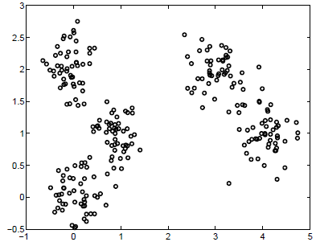
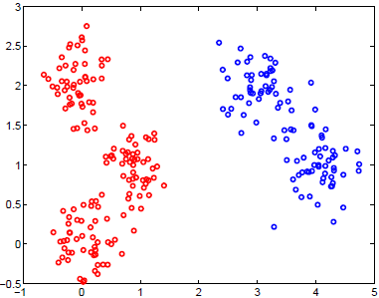
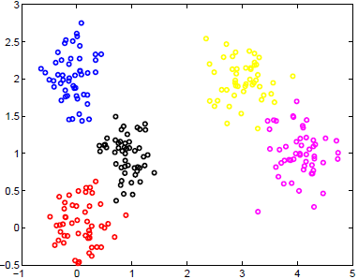
Illustrative Example
How many clusters?

Slide 7
Types of clustering
There are different types of clustering algorithms, including. centroid-based clustering algorithms
connectivity-based clustering algorithms (hierarchical clustering)
distribution-based clustering algorithms
density-based clustering algorithms.

Slide 8
Applications of clustering
Document Classification
Delivery Store Optimization
Identifying Crime Localities
Customer Segmentation
Insurance Fraud Detection
Traffic Data Analysis
Cyber-Profiling Criminals
Call Record Detail Analysis
Automatic Clustering of It Alerts

Slide 9
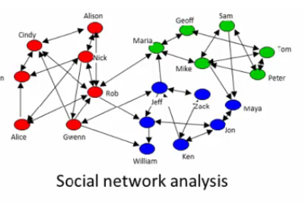
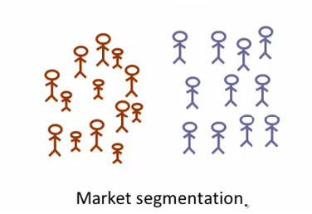
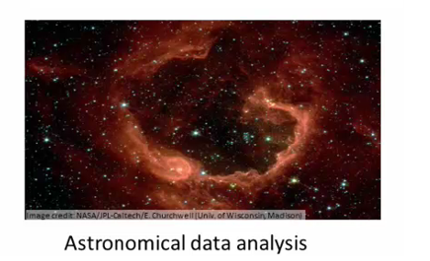
Applications
Real Applications: Emerging Applications
Notes:
Server clustering
Grouping customers based on their favours
Social networks: discover close-knit cluster
Use galaxy cluster to study universal mass

Slide 10
Clustering Techniques
Partitioning algorithms: Construct various partitions and then evaluate them by some criterion
- K-mean
Hierarchical algorithms: Create a hierarchical decomposition of the set of objects using some criterion
-Agglomerative
-Divisible

Slide 11
k-Means Algorithm
Input: D is a dataset containing n objects, k is the number of cluster
Output: A set of k clusters
Steps:
Randomly choose k objects from D as the initial cluster centroids.
For each of the objects in D do
Compute distance between the current objects and k cluster centroids
Assign the current object to that cluster to which it is closest.
Compute the “cluster centers” of each cluster. These become the new cluster centroids.
Repeat step 2-3 until the convergence criterion is satisfied
Stop

Slide 12
k-Means
Step 1
Step 2
Step 3
10
10
9
9
8
8
7
7
6
6
5
5
4
4
3
3
2
2
1
1
0
0
1
2
3
4
5
6
7
8
9
10
0
0
1
2
3
4
5
6
7
8
9
10
Step 4

Slide 13
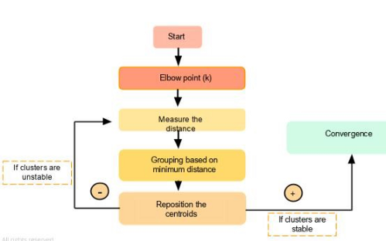
Steps of K-Mean

Slide 14

Eucledean Distance
Euclidean Distance between two points in space: If p = (p1, p2) and q = (q1, q2) then the distance is given by

Slide 15

Illustration of k-Means clustering algorithms
Table 1objects with two attributes $A_{1}$ and $A_{2}$.
Fig 1: Plotting data of Table 1
A₁ | A₂
6.8 | 12.6
0.8 | 9.8
1.2 | 11.6
2.8 | 9.6
3.8 | 9.9
4.4 | 6.5
4.8 | 1.1
6.0 | 19.9
6.2 | 18.5
7.6 | 17.4
7.8 | 12.2
6.6 | 7.7
8.2 | 4.5
8.4 | 6.9
9.0 | 3.4
9.6 | 11.1

Slide 16
Illustration of k-Means clustering algorithms
Suppose, k=3. Three objects are chosen at random shown as circled These three centroids are shown below.
Initial Centroids chosen randomly
Let us consider the Euclidean distance measure as the distance measurement in our illustration.
Let d₁, d₂ and d₃ denote the distance from an object to c₁, c₂ and c₃ respectively. The distance calculations are shown in Table 2.
Assignment of each object to the respective centroid.
Centroid |  | Objects
 | A1 |  | A2
c₁ | 3.8 |  | 9.9
c₂ | 7.8 |  | 12.2
c₃ | 6.2 |  | 18.5

Slide 17
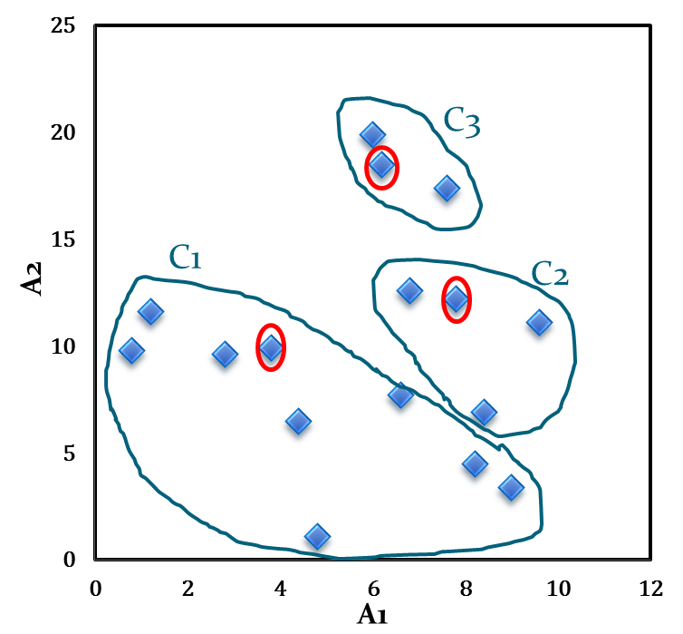
Illustration of k-Means clustering algorithms
Table 2: Distance calculation
Fig .2: Initial cluster with respect to Table 2
A₁ | A₂ | d₁ | d₂ | d₃ | _{cluster}
6.8 | 12.6 | 4.0 | 1.1 | 5.9 | 2
0.8 | 9.8 | 3.0 | 7.4 | 10.2 | 1
1.2 | 11.6 | 3.1 | 6.6 | 8.5 | 1
2.8 | 9.6 | 1.0 | 5.6 | 9.5 | 1
3.8 | 9.9 | 0.0 | 4.6 | 8.9 | 1
4.4 | 6.5 | 3.5 | 6.6 | 12.1 | 1
4.8 | 1.1 | 8.9 | 11.5 | 17.5 | 1
6.0 | 19.9 | 10.2 | 7.9 | 1.4 | 3
6.2 | 18.5 | 8.9 | 6.5 | 0.0 | 3
7.6 | 17.4 | 8.4 | 5.2 | 1.8 | 3
7.8 | 12.2 | 4.6 | 0.0 | 6.5 | 2
6.6 | 7.7 | 3.6 | 4.7 | 10.8 | 1
8.2 | 4.5 | 7.0 | 7.7 | 14.1 | 1
8.4 | 6.9 | 5.5 | 5.3 | 11.8 | 2
9.0 | 3.4 | 8.3 | 8.9 | 15.4 | 1
9.6 | 11.1 | 5.9 | 2.1 | 8.1 | 2

Slide 18
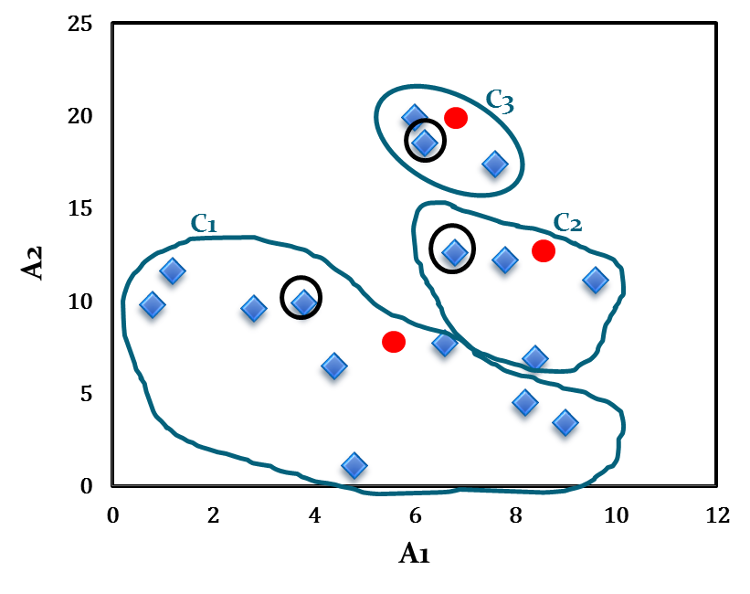
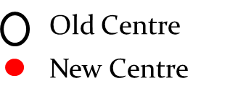
Illustration of k-Means clustering algorithms
The calculation new centroids of the three cluster using the mean of attribute values of A₁ and A₂ is shown in the Table below. The cluster with new centroids are shown in Fig 3.
Calculation of new centroids
New Centroid |  | Objects
 | A1 |  | A2
c₁ | 4.6 |  | 7.1
c₂ | 8.2 |  | 10.7
c₃ | 6.6 |  | 18.6
Figure.3: Initial cluster with new centroids

Slide 19
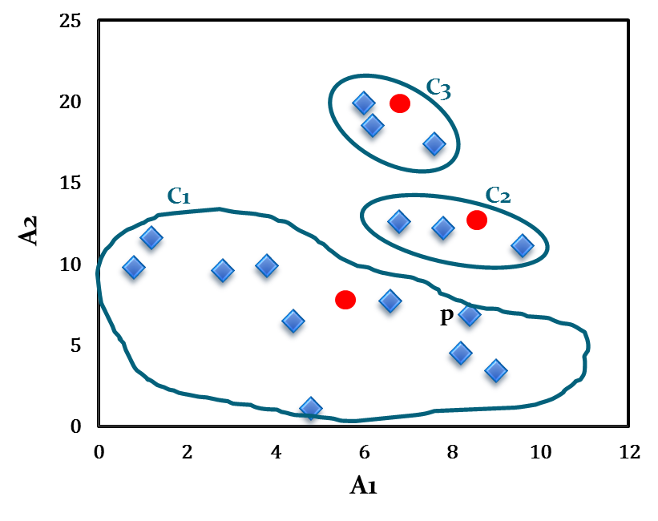
Illustration of k-Means clustering algorithms
We next reassign the 16 objects to three clusters by determining which centroid is closest to each one. This gives the revised set of clusters shown in Fig 4.
Note that point p moves from cluster C₂ to cluster C₁.
Fig .4: Cluster after first iteration

Slide 20
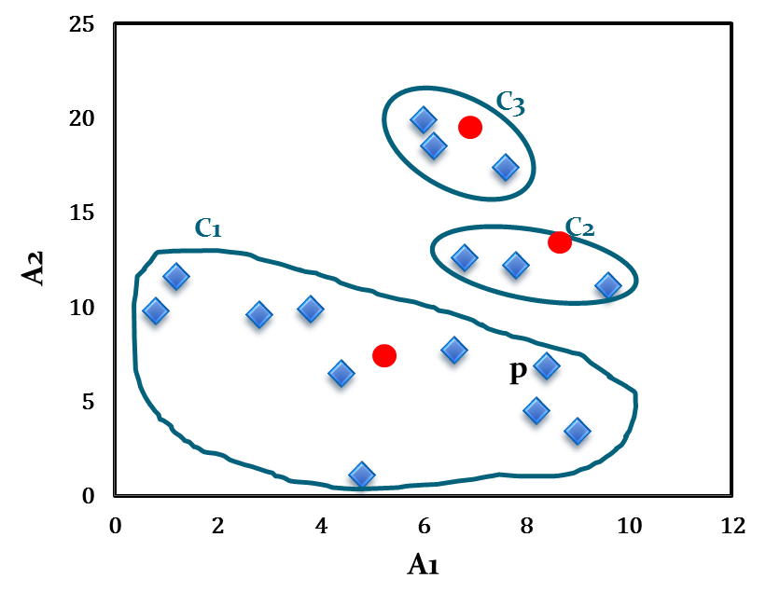
Illustration of k-Means clustering algorithms
The newly obtained centroids after second iteration are given in the table below. Note that the centroid c₃ remains unchanged, where c₂ and c₁ changed a little.
With respect to newly obtained cluster centres, 16 points are reassigned again. These are the same clusters as before. Hence, their centroids also remain unchanged.
Considering this as the termination criteria, the k-means algorithm stops here. Hence, the final cluster in Fig 5 is same as Fig 4.
Fig .5: Cluster after Second iteration
Cluster centres after second iteration
Centroid | Revised Centroids
 | A1 | A2
c₁ | 5.0 | 7.1
c₂ | 8.1 | 12.0
c₃ | 6.6 | 18.6

Slide 21
Example 2
No. | Height(h) | Weight(W)
1 | 185 | 72
2 | 170 | 56
3 | 168 | 60
4 | 179 | 68
5 | 182 | 72
6 | 188 | 77
7 | 180 | 71
8 | 180 | 70
9 | 183 | 84
10 | 180 | 88
11 | 180 | 67
12 | 177 | 76
Suppose no. Of centre is two
C1=(185,72)
C2=((170,56)
Assign the data in the different rows to the centroids

Slide 22
Ideal no. of clusters
The number of clusters that we choose for a given dataset cannot be random.
An ideal way to figure out the right number of clusters would be to calculate the Within-Cluster-Sum-of-Squares (WCSS).
WCSS is the sum of squares of the distances of each data point in all clusters to their respective centroids.
By Elbow method to decide optimum no. of clusters

Slide 23
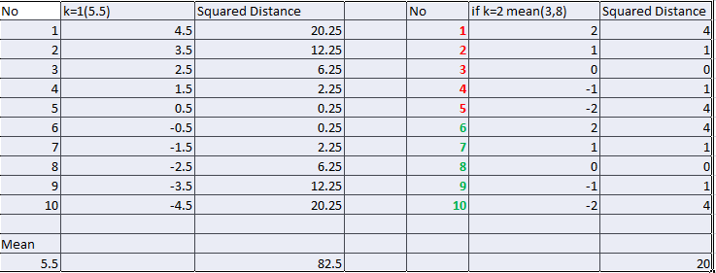
Example of calculating Sum squared error

Slide 24
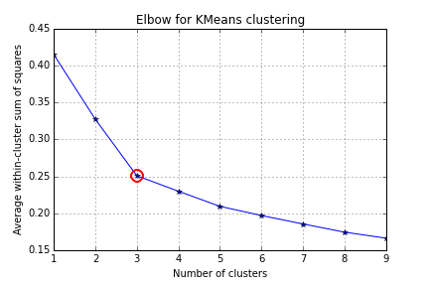
The Elbow Method

Slide 25
silhouette coefficient
The silhouette coefficient is a measure of cluster cohesion and separation.
It quantifies how well a data point fits into its assigned cluster based on two factors:
1. How close the data point is to other points in the cluster
How far away the data point is from points in other clusters
Silhouette coefficient values range between -1 and 1.
Larger numbers indicate that samples are closer to their clusters than they are to other clusters.
In the scikit-learn implementation ,the silhouette score() function is used to measure the silhouette coefficient,

Slide 26
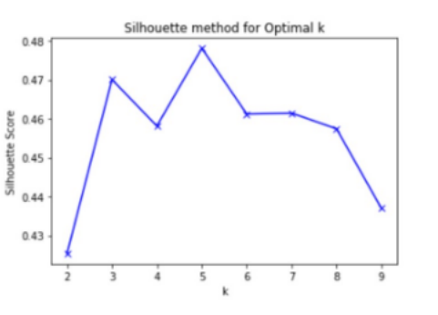
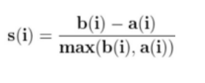
Calculation of Silhouette coefficient
It is apparent that the Silhouette Coefficient is calculated for all data points (observations).
1. Compute a(i): The average distance of that point with all other points in the same clusters.
2. Compute b(i): The average distance of that point with all the points in the closest cluster to its cluster.
3. Compute s(i) — silhouette coefficient of ‘i’th observation using below mentioned formula.
After computing the silhouette coefficient for each point, average it out to get the silhouette score.
As per this method k=5 should be chosen for the number of clusters.
This method is better as it makes the decision regarding the optimal number of clusters more meaningful and clearer.
But this metric is computation expensive as the coefficient is calculated for every instance

Slide 27
Hierarchical Clustering
Hierarchical Clustering is a connectivity-based clustering algorithms.
It is based on the core idea that similar objects lie nearby to each other in a data space while others lie far away.
It uses distance functions to find nearby data points and group the data points together as clusters.
There are two major types of approaches in hierarchical clustering:
Agglomerative clustering: Divide the data points into different clusters and then aggregate them as the distance decreases.
Divisive clustering: Combine all the data points as a single cluster and divide them as the distance between them increases.

Slide 28
Agglomerative Clustering
Agglomerative clustering is a bottom-up approach.
It starts clustering by treating the individual data points as a single cluster then it is merged continuously based on similarity until it forms one big cluster containing all objects.
It is good at identifying small clusters.
The steps for agglomerative clustering are as follows:
Compute the proximity matrix using a distance metric.
Use a linkage function to group objects into a hierarchical cluster tree based on the computed distance matrix from the above step.
Data points with close proximity are merged together to form a cluster.
Repeat steps 2 and 3 until a single cluster remains.

Slide 29
Hierarchical Clustering
Step 0
Step 1
Step 2
Step 3
Step 4
Agglomerative
a
a b
b
a b c d e
c
c d e
d
d e
e
Notes:
How do decide on which pair of clusters to combine?

Slide 30
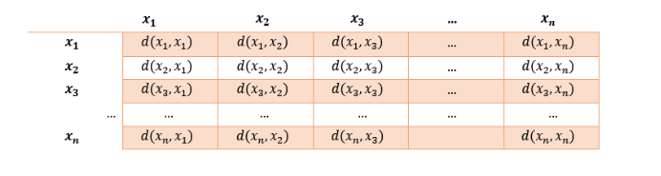
Proximity matrix
The proximity matrix is a matrix consisting of the distance between each pair of data points.
The distance is computed by a distance function. Euclidean distance is one of the most commonly used distance functions.
The above proximity matrix consists of n points named x, and the d(xi,xj) represents the distance between the points.
In order to group the data points in a cluster, a linkage function is used where the values in the proximity matrix are taken and the data points are grouped based on similarity. The newly formed clusters are linked to each other until it forms a single cluster containing all the data points.

Slide 31
Hierarchical Clustering (top down)
a
a b
b
a b c d e
c
c d e
d
d e
e
Divisive
Step 4
Step 3
Step 2
Step 1
Step 0
In either case, one gets a nice dendogram in which any maximal anti-chain (no 2 nodes linked) is a clustering (partition).
Notes:
How do decide on which pair of clusters to combine?

Slide 32
Hierarchical Clustering (Cont.)
Most hierarchical clustering algorithms are variants of the single-link, complete-link or average link.
Of these, single-link and complete link are most popular.
In the single-link method, the distance between two clusters is the minimum of the distances between all pairs of patterns drawn one from each cluster.
In the complete-link algorithm, the distance between two clusters is the maximum of all pairwise distances between pairs of patterns drawn one from each cluster.
In the average-link algorithm, the distance between two clusters is the average of all pairwise distances between pairs of patterns drawn one from each cluster (which is the same as the distance between the means in the vector space case – easier to calculate).

Slide 33
Distance Between Clusters
Single Link: smallest distance between any pair of points from two clusters
Complete Link: largest distance between any pair of points from two clusters

Slide 34
Distance between Clusters (Cont.)
Average Link: average distance between points from two clusters
Centroid: distance between centroids of the two clusters

Slide 35
Applications
A technique demanded by many real world tasks
Bank/Internet Security: fraud/spam pattern discovery
Biology: taxonomy of living things such as kingdom, phylum, class, order, family, genus and species
City-planning: Identifying groups of houses according to their house type, value, and geographical location
Climate change: understanding earth climate, find patterns of atmospheric and ocean
Finance: stock clustering analysis to uncover correlation underlying shares
Image Compression/segmentation: coherent pixels grouped
Information retrieval/organisation: Google search, topic-based news
Land use: Identification of areas of similar land use in an earth observation database
Marketing: Help marketers discover distinct groups in their customer bases, and then use this knowledge to develop targeted marketing programs
Social network mining: special interest group automatic discovery

Slide 36
Thank You

